Slide 1
Chapter 11
Further Issues in Using OLS with Time Series Data

Slide 2
Further Issues in Using OLS with Time Series Data (1 of 21)
The assumptions used so far seem to be too restricitive
Strict exogeneity, homoskedasticity, and no serial correlation are very demanding requirements, especially in the time series context.
Statistical inference rests on the validity of the normality assumption
Much weaker assumptions are needed if the sample size is large.
A key requirement for large sample analysis of time series is that the time series in question are stationary and weakly dependent.
Stationary time series
Loosely speaking, a time series is stationary if its stochastic properties and its temporal dependence structure do not change over time.

Slide 3
Further Issues in Using OLS with Time Series Data (2 of 21)
Stationary stochastic processes
A stochastic process {x_{t}: t = 1,2,...,} is stationary, if for every collection of indices 1 ≤ t₁ ≤ t₂ ≤ ... ≤ t_{m} the joint distribution of (x_{1t}, x_{2t},...,x_{mt}) is the same as that of (x_{1t+h}, x_{2t+h}, ...,x_{mt+h}) for all integers h ≥ 1.
Covariance stationary process
A stochastic process {x_{t}: t = 1,2,...,} is covariance stationary, if its expected value, its variance, and its covariance are constant over time:

Slide 4
Further Issues in Using OLS with Time Series Data (3 of 21)
Weakly dependent time series
A stochastic process {x_{t}: t = 1,2,...,} is weakly dependent, if x_{t} is almost independent of x_{t+h} as h grows to infinity (for all t).
Discussion of the weak dependence property
An implication of weak dependence is that the correlation between x_{t} and x_{t+h} must converge to zero if h grows to infinity.
For the LLN and the CLT to hold, the individual observations must not be too strongly related to each other; in particular their relation must become weaker (and this fast enough) the farther they are apart.
Note that a series may be nonstationary but weakly dependent.

Slide 5
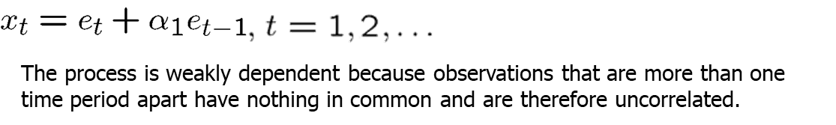
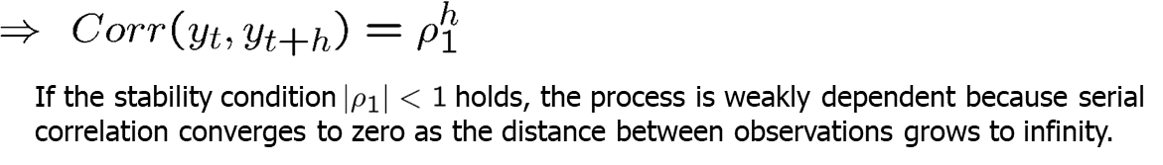
Further Issues in Using OLS with Time Series Data (4 of 21)
Examples for weakly dependent time series
Moving average process of order one [MA(1)]
Autoregressive process of order one [AR(1)]

Slide 6
Further Issues in Using OLS with Time Series Data (5 of 21)
Asymptotic properties of OLS
Assumption TS.1‘ (Linear in parameters)
Same as assumption TS.1 but now the dependent and independent variables are assumed to be stationary and weakly dependent.
Assumption TS.2‘ (No perfect collinearity)
Same as assumption TS.2
Assumption TS.3‘ (Zero conditional mean)
Now the explanatory variables are assumed to be only contempo-raneously exogenous rather than strictly exogenous, i.e.

Slide 7
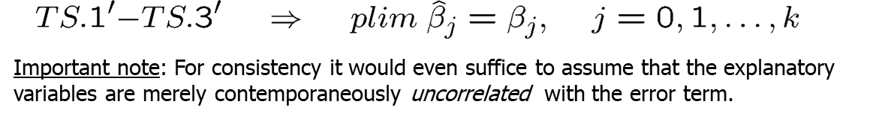
Further Issues in Using OLS with Time Series Data (6 of 21)
Theorem 11.1 (Consistency of OLS)
Why is it important to relax the strict exogeneity assumption?
Strict exogeneity is a serious restriction because it rules out all kinds of dynamic relationships between explanatory variables and the error term.
In particular, it rules out feedback from the dependent variable on future values of the explanatory variables (which is very common in economic contexts).
Strict exogeneity precludes the use of lagged dependent variable as regressors.

Slide 8
Further Issues in Using OLS with Time Series Data (7 of 21)
Why do lagged dependent variables violate strict exogeneity?
This leads to a contradiction because:
OLS estimation in the presence of lagged dependent variables
Under contemporaneous exogeneity, OLS is consistent but biased.

Slide 9
Further Issues in Using OLS with Time Series Data (8 of 21)
Assumption TS.4‘ (Homoskedasticity)
Assumption TS.5‘ (No serial correlation)
Theorem 11.2 (Asymptotic normality of OLS)
Under assumptions TS.1‘ – TS.5‘, the OLS estimators are asymptotically normally distributed. Further, the usual OLS standard errors, t-statistics, F-statistics, and LM statistics are asymptotically valid.

Slide 10
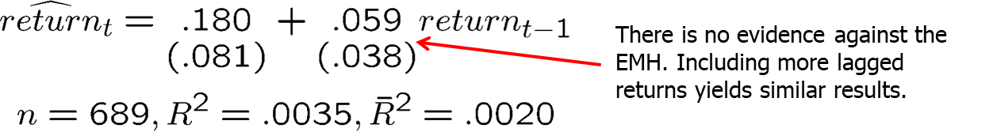
Further Issues in Using OLS with Time Series Data (9 of 21)
Example: Efficient Markets Hypothesis (EMH)
The EMH in a strict form states that information observable to the market prior to week t should not help to predict the return during week t. A simplification assumes in addition that only past returns are considered as relevant information to predict the return in week t. This implies that:
A simple way to test the EMH is to specify an AR(1) model. Under the EMH, assumption TS.3‘ holds so that an OLS regression can be used to test whether this week‘s returns depend on last week‘s returns.

Slide 11
Further Issues in Using OLS with Time Series Data (10 of 21)
Using trend-stationary series in regression analysis
Time series with deterministic time trends are nonstationary.
If they are stationary around the trend and in addition weakly dependent, they are called trend-stationary processes.
Trend-stationary processes also satisfy assumption TS.1‘
Using highly persistent time series in regression analysis
Unfortunately many economic time series violate weak dependence because they are highly persistent (= strongly dependent).
In this case OLS methods are generally invalid (unless the CLM hold).
In some cases transformations to weak dependence are possible.

Slide 12
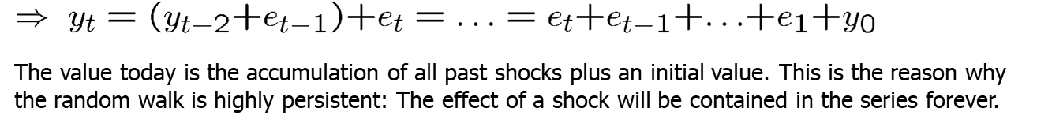
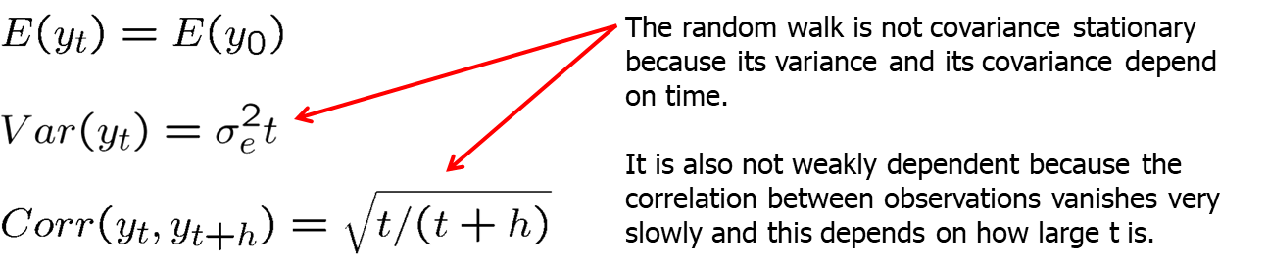
Further Issues in Using OLS with Time Series Data (11 of 21)
Random walks

Slide 13
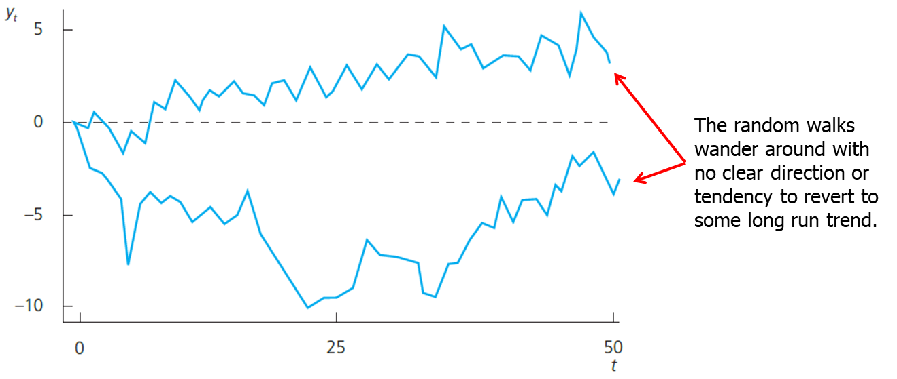
Further Issues in Using OLS with Time Series Data (12 of 21)
Examples for random walk realizations

Slide 14
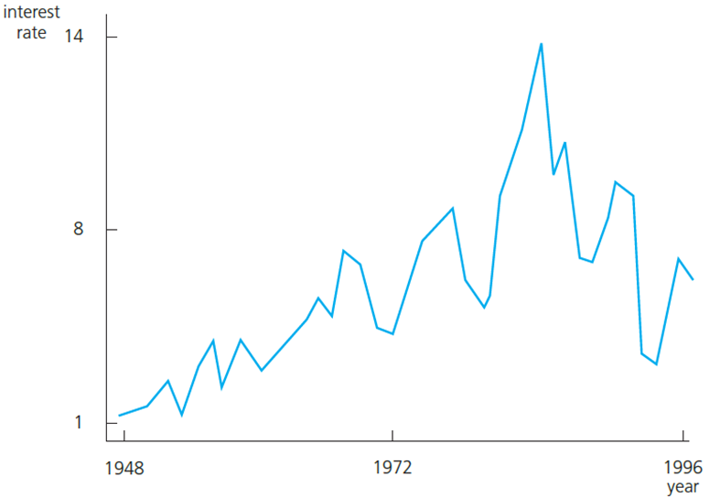
Further Issues in Using OLS with Time Series Data (13 of 21)
Three-month T-bill rate as a possible example for a random walk
A random walk is a special case of a unit root process.
Unit root processes are defined as a random walk, but e_{t} may be an arbitrary weakly dependent process.
From an economic point of view it is important to know whether a time series is highly persistent. In highly persistent time series, shocks or policy changes have lasting/permanent effects, in weakly dependent processes their effects are transitory.

Slide 15
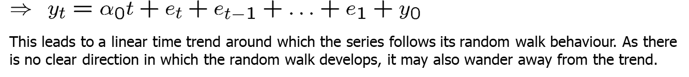
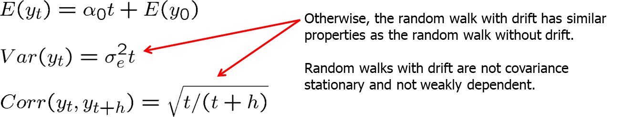
Further Issues in Using OLS with Time Series Data (14 of 21)
Random walks with drift

Slide 16
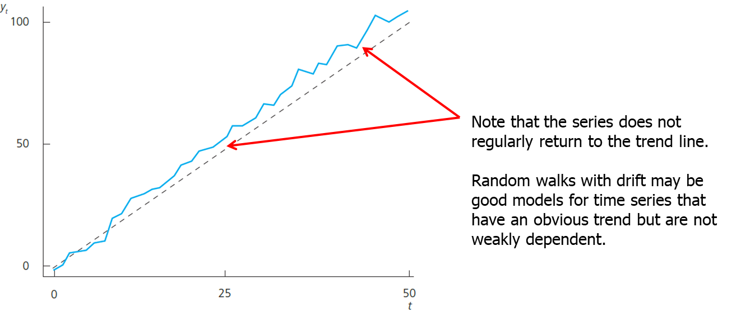
Further Issues in Using OLS with Time Series Data (15 of 21)
Sample path of a random walk with drift

Slide 17

Further Issues in Using OLS with Time Series Data (16 of 21)
Transformations on highly persistent time series
Order of integration
Weakly dependent time series are integrated of order zero (= I(0))
If a time series has to be differenced one time in order to obtain a weakly dependent series, it is called integrated of order one (= I(1))
Examples for I(1) processes
Differencing is often a way to achieve weak dependence.

Slide 18
Further Issues in Using OLS with Time Series Data (17 of 21)
Deciding whether a time series is I(1)
There are statistical tests (unit root tests) for testing whether a time series is I(1); these will be covered in later chapters.
Alternatively, look at the sample first order autocorrelation:
If the sample first order autocorrelation is close to one, this suggests that the time series may be highly persistent (= contains a unit root).
Alternatively, the series may have a deterministic trend.
Both unit root and trend may be eliminated by differencing.

Slide 19
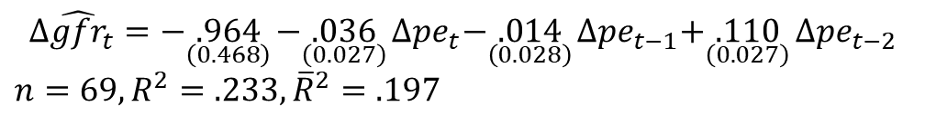
Further Issues in Using OLS with Time Series Data (18 of 21)
Example: Fertility equation
This equation could be estimated by OLS if the CLM assumptions hold. These may be questionable, so that one would have to resort to large sample analysis. For large sample analysis, the fertility series and the series of the personal tax exemption have to be stationary and weakly dependent. This is questionable because the two series are highly persistent:
It is therefore better to estimate the equation in first differences. This makes sense because if the equation holds in levels, it also has to hold in first differences:

Slide 20
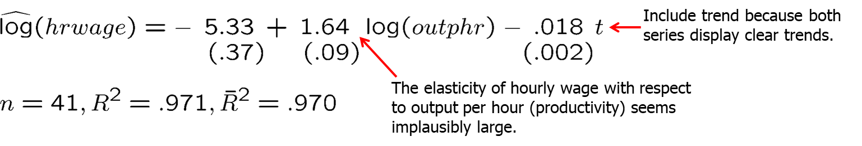
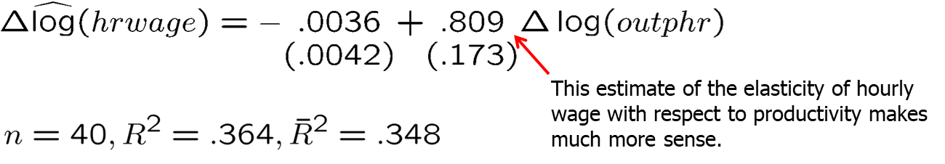
Further Issues in Using OLS with Time Series Data (19 of 21)
Example: Wages and productivity
It turns out that even after detrending, both series display sample autocorrelations close to one so that estimating the equation in first differences seems more adequate:

Slide 21
Further Issues in Using OLS with Time Series Data (20 of 21)
Dynamically complete models
A model is said to be dynamically complete if enough lagged variables have been included as explanatory variables so that further lags do not help to explain the dependent variable:
Dynamic completeness implies absence of serial correlation
If further lags actually belong in the regression, their omission will cause serial correlation (if the variables are serially correlated).
One can easily test for dynamic completeness
If lags cannot be excluded, this suggests there is serial correlation.

Slide 22
Further Issues in Using OLS with Time Series Data (21 of 21)
Sequential exogeneity
A set of explanatory variables is said to be sequentially exogenous if “enough” lagged explanatory variables have been included:
Sequential exogeneity is weaker than strict exogeneity.
Sequential exogeneity is equivalent to dynamic completeness if the explanatory variables contain a lagged dependent variable.
Should all regression models be dynamically complete?
Not necessarily: If sequential exogeneity holds, causal effects will be correctly estimated; absence of serial correlation is not crucial.

